Slide 1

Goal Seek

Slide 2
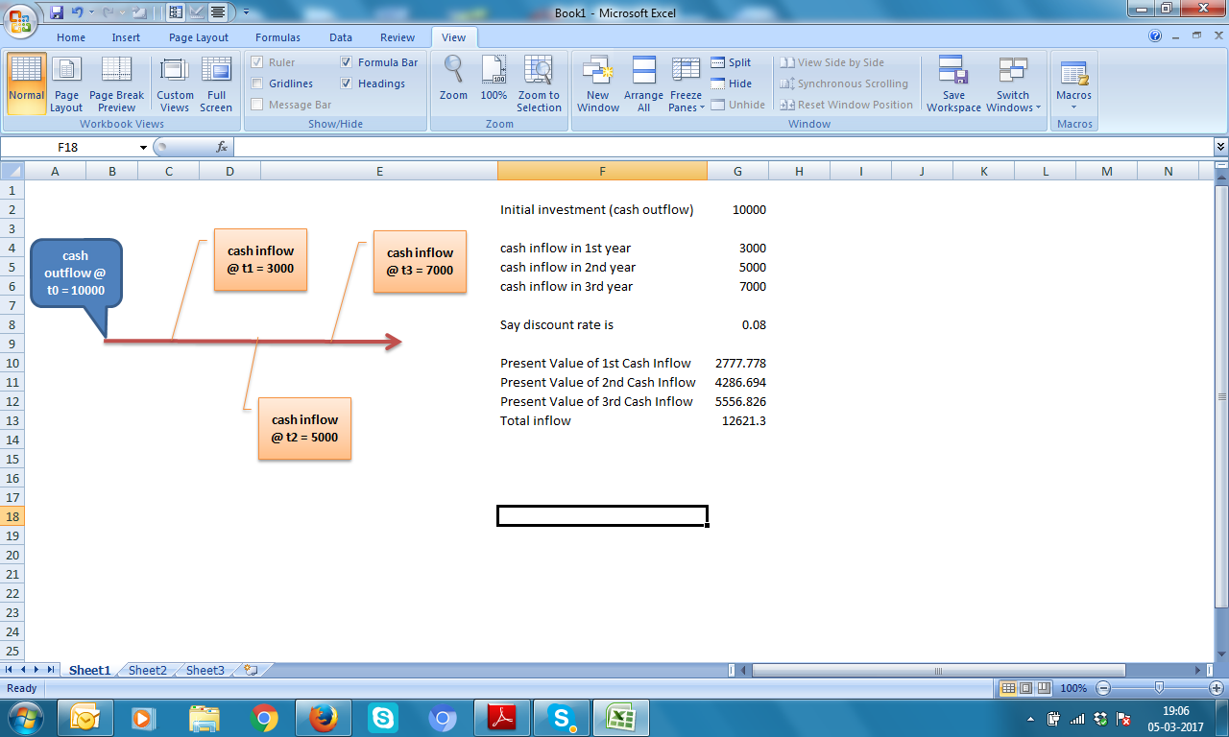
Find IRR Internal Rate of Return

Slide 3



Computation method for IRR
Try keeping different values of r. keep r in decimals like 0.07 for 7%,
0.09 for 9% , 0.12 for 12% and so on

Slide 4
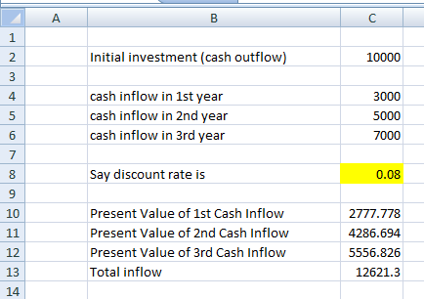
Set up excel sheet

Slide 5
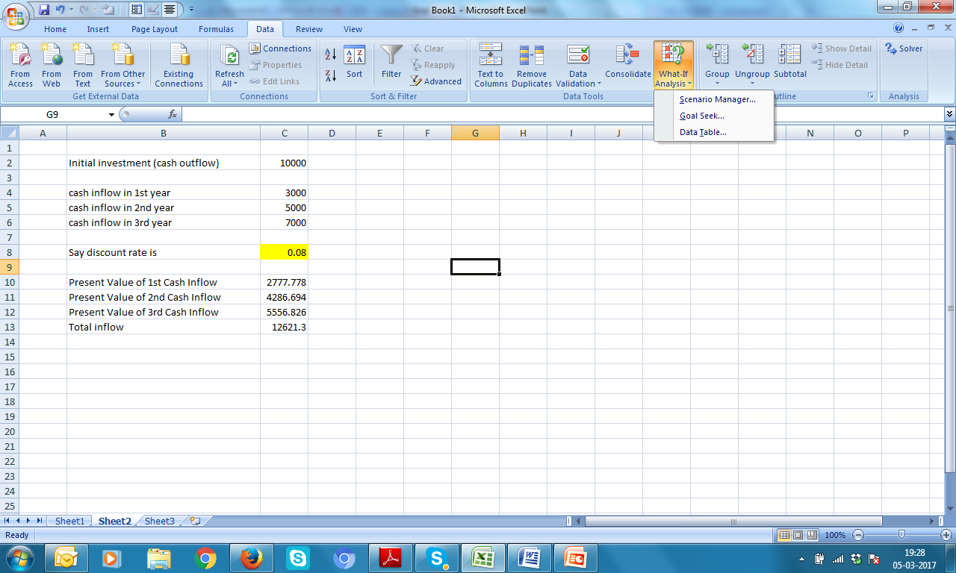

Slide 6
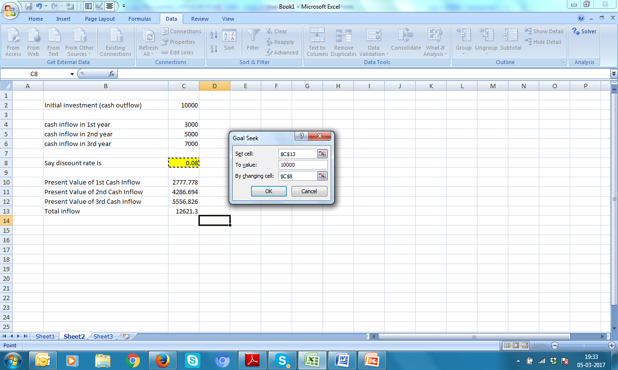

Slide 7

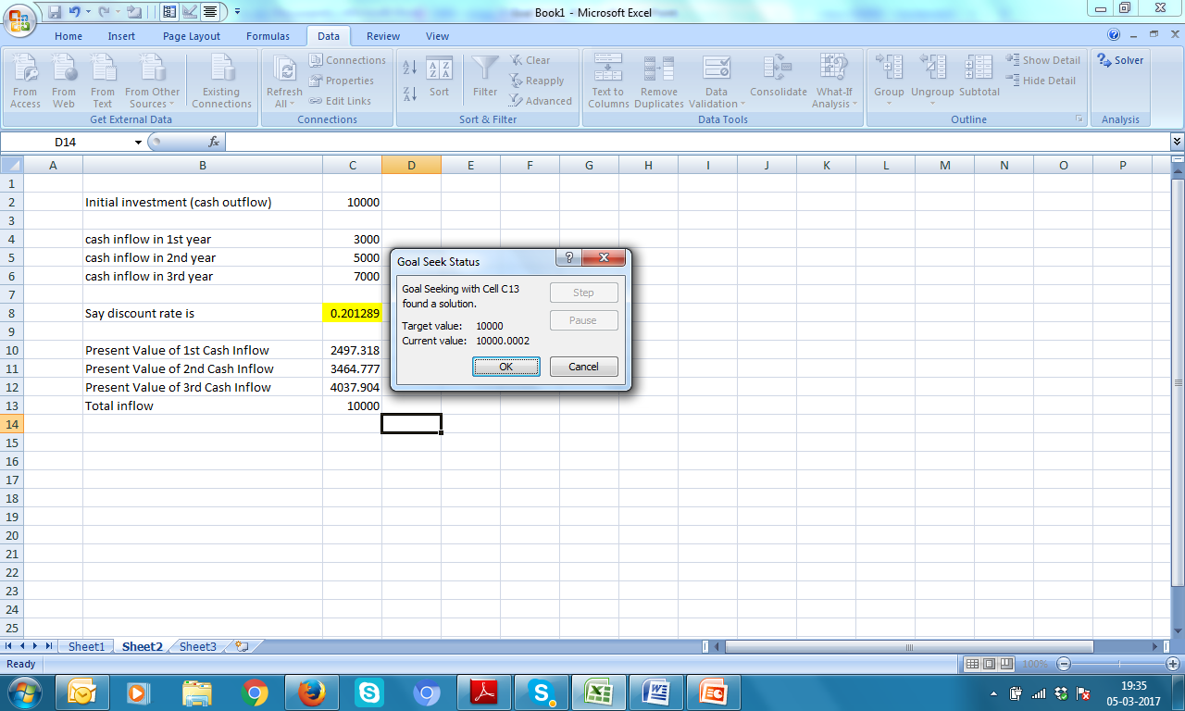

Slide 8


